Slide 1

An IoT-Based Announcement System

Slide 2
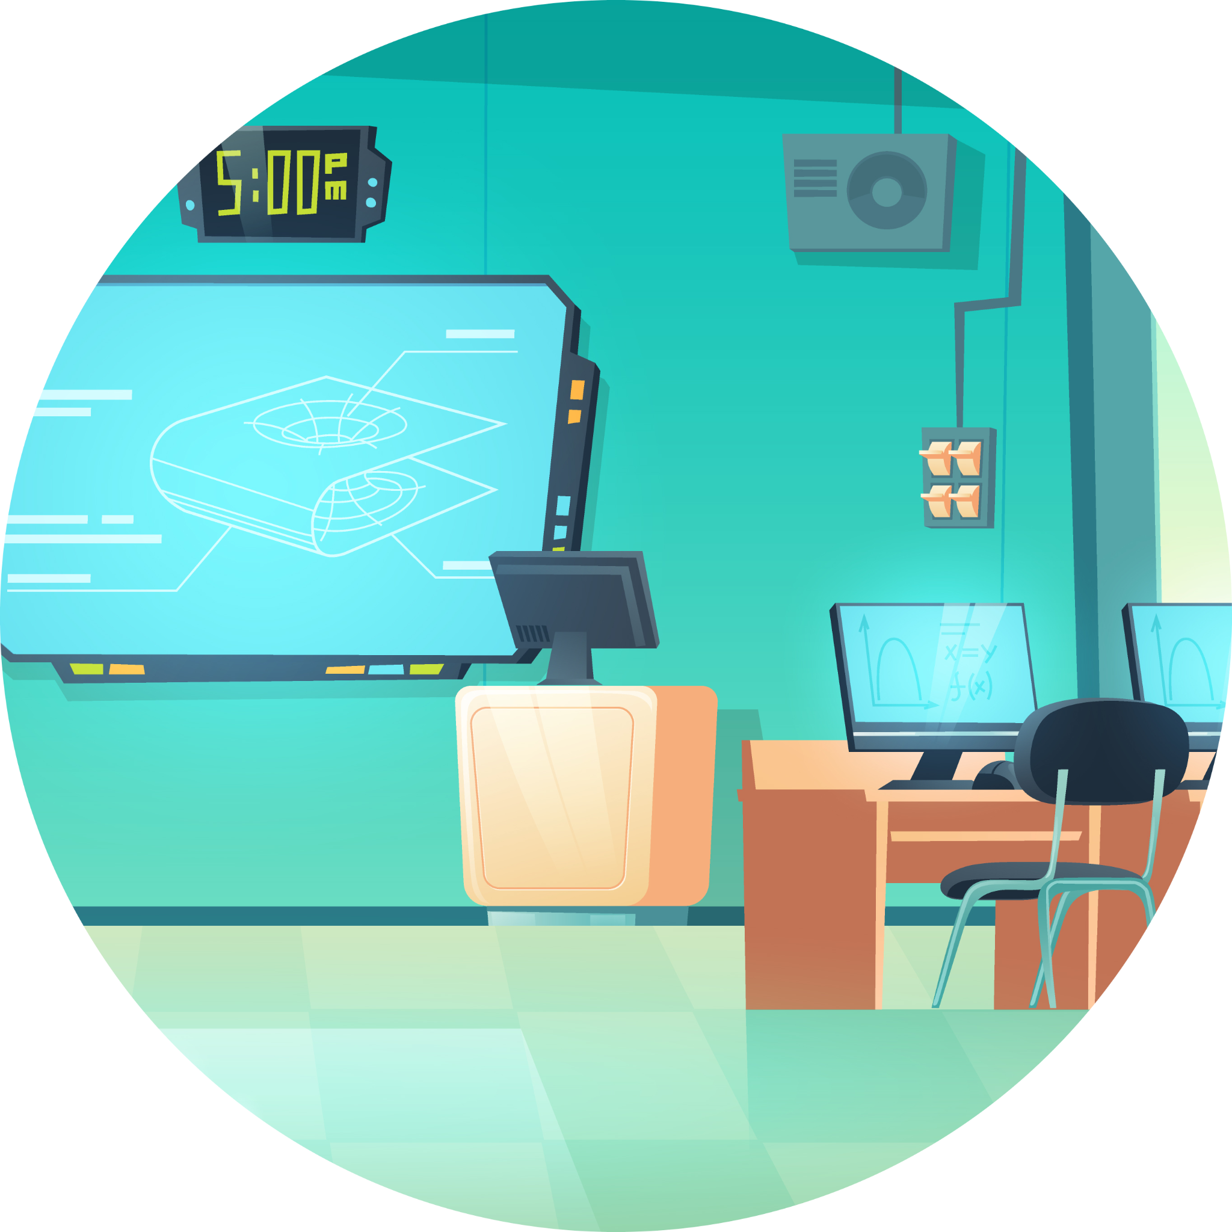
Introduction
Welcome to CampusCast, an IoT-based announcement system that offers a modern and efficient solution for communication within academic institutions. With this system, college authorities can easily send voice announcements with customizable routes to specific classrooms, branches, years, or classes. CampusCast helps save time and resources by providing a targeted and timely communication channel, while also keeping students and faculty informed about important updates and events.

Slide 3
Problem Statement
In many colleges, teachers send announcements or important messages through WhatsApp groups while students are attending classes. However, it can be difficult for students to check their smartphones and receive timely notifications while in class.
Some students rely on hostel WiFi to access WhatsApp messages, but many colleges do not provide WiFi on campus, making it challenging for students to stay connected and receive important updates.
During exams, the bell system often favors regular classes, leaving students taking exams without proper time alerts. Even if they have smartwatches, these devices are not allowed in classrooms.

Slide 4

Our Solution:
Revolutionizing Campus Communication
CampusCast is an IoT-based announcement system that revolutionizes campus communication by providing a smart and efficient way for teachers and students to stay connected.
With CampusCast , teachers can send announcements, reminders, and important messages to students instantly through a centralized system that ensures every message is received and acknowledged.
CampusCast provides a feature called "Smart Notification" that ensures students receive important messages at the right time, without interrupting their class activities. This feature allows students to receive notifications via a smart speaker, without having to check their smartphones.

Slide 5
Our Solution:
Revolutionizing Campus Communication
CampusCast also provides a feature called "Exam Time Alerts" that sends notifications to students attending exams, ensuring they are informed about exam times. This feature helps to eliminate the need for the traditional bell system, which can be disruptive to exam-taking students.
With CampusCast, students can also receive messages and announcements even if they don't have access to Wi-Fi on campus. The system uses IoT technology that ensures messages are delivered with the acknowledgement.
CampusCast is easy to use and user-friendly, allowing you to send announcements quickly and easily, similar to sending a snap on the Snapchat app.

Slide 6
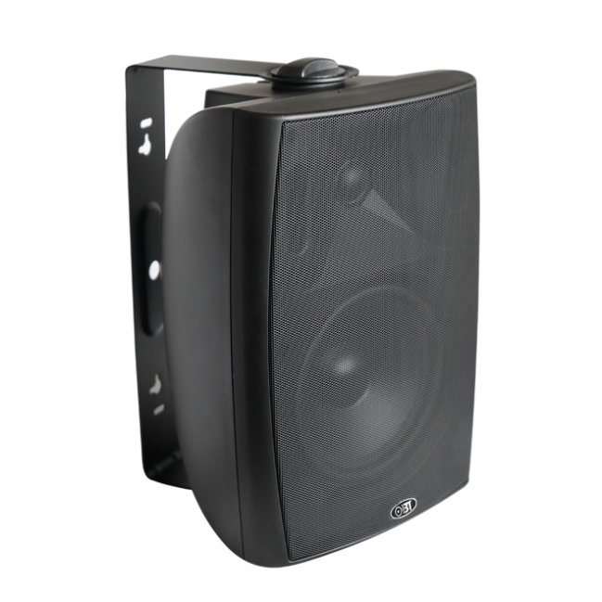
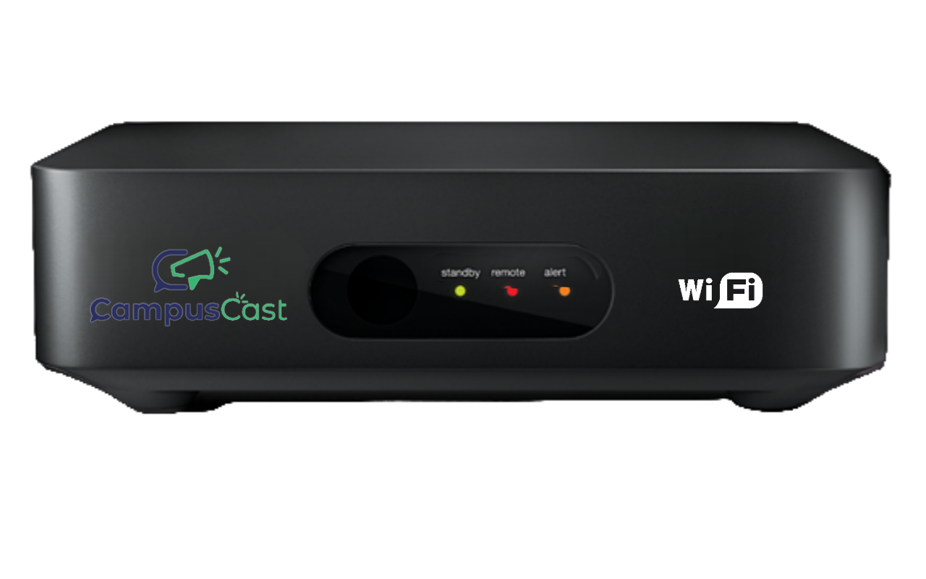
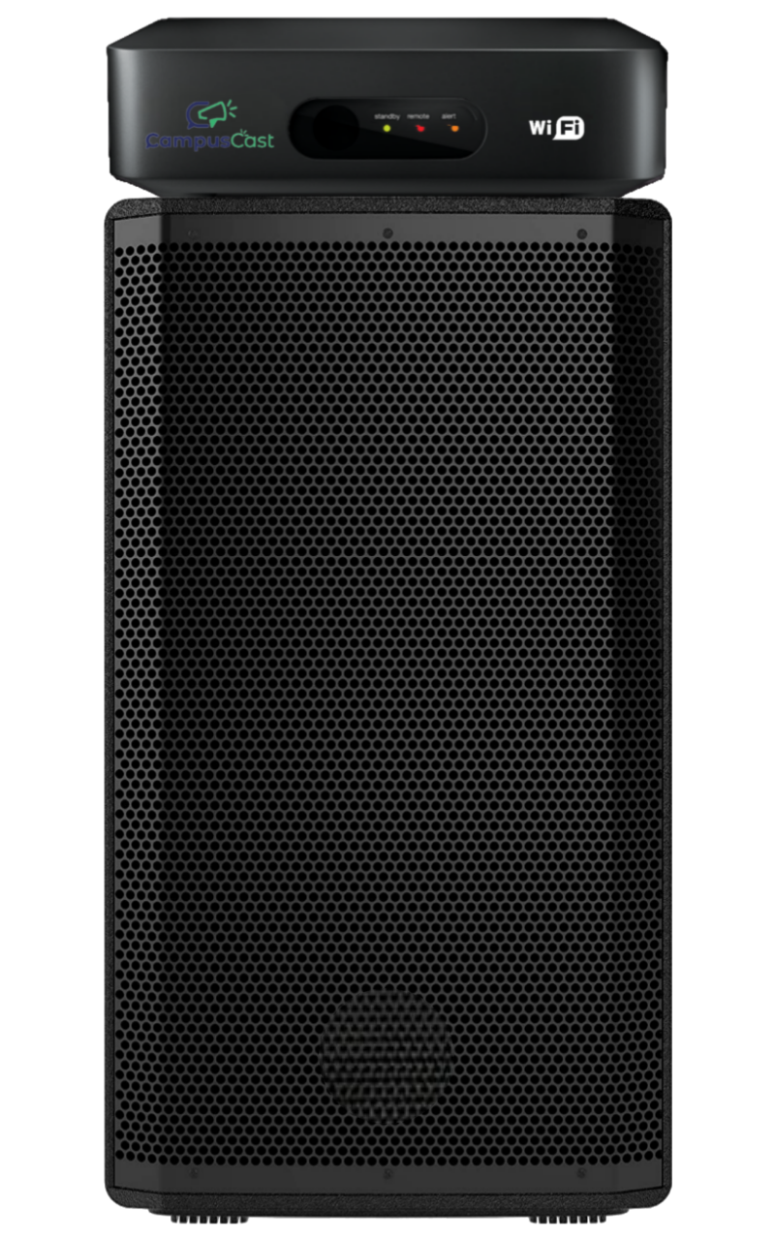
Hardware System
Traditional
Speaker
+
CampusCast consists of both hardware and software systems
The hardware system is an IoT device that is designed to connect with the traditional college/campus announcement speakers
By connecting the CampusCast device to the speaker, it transforms the speaker into a smart speaker
CampusCast
Device
=
Smart IoT Speaker

Slide 7
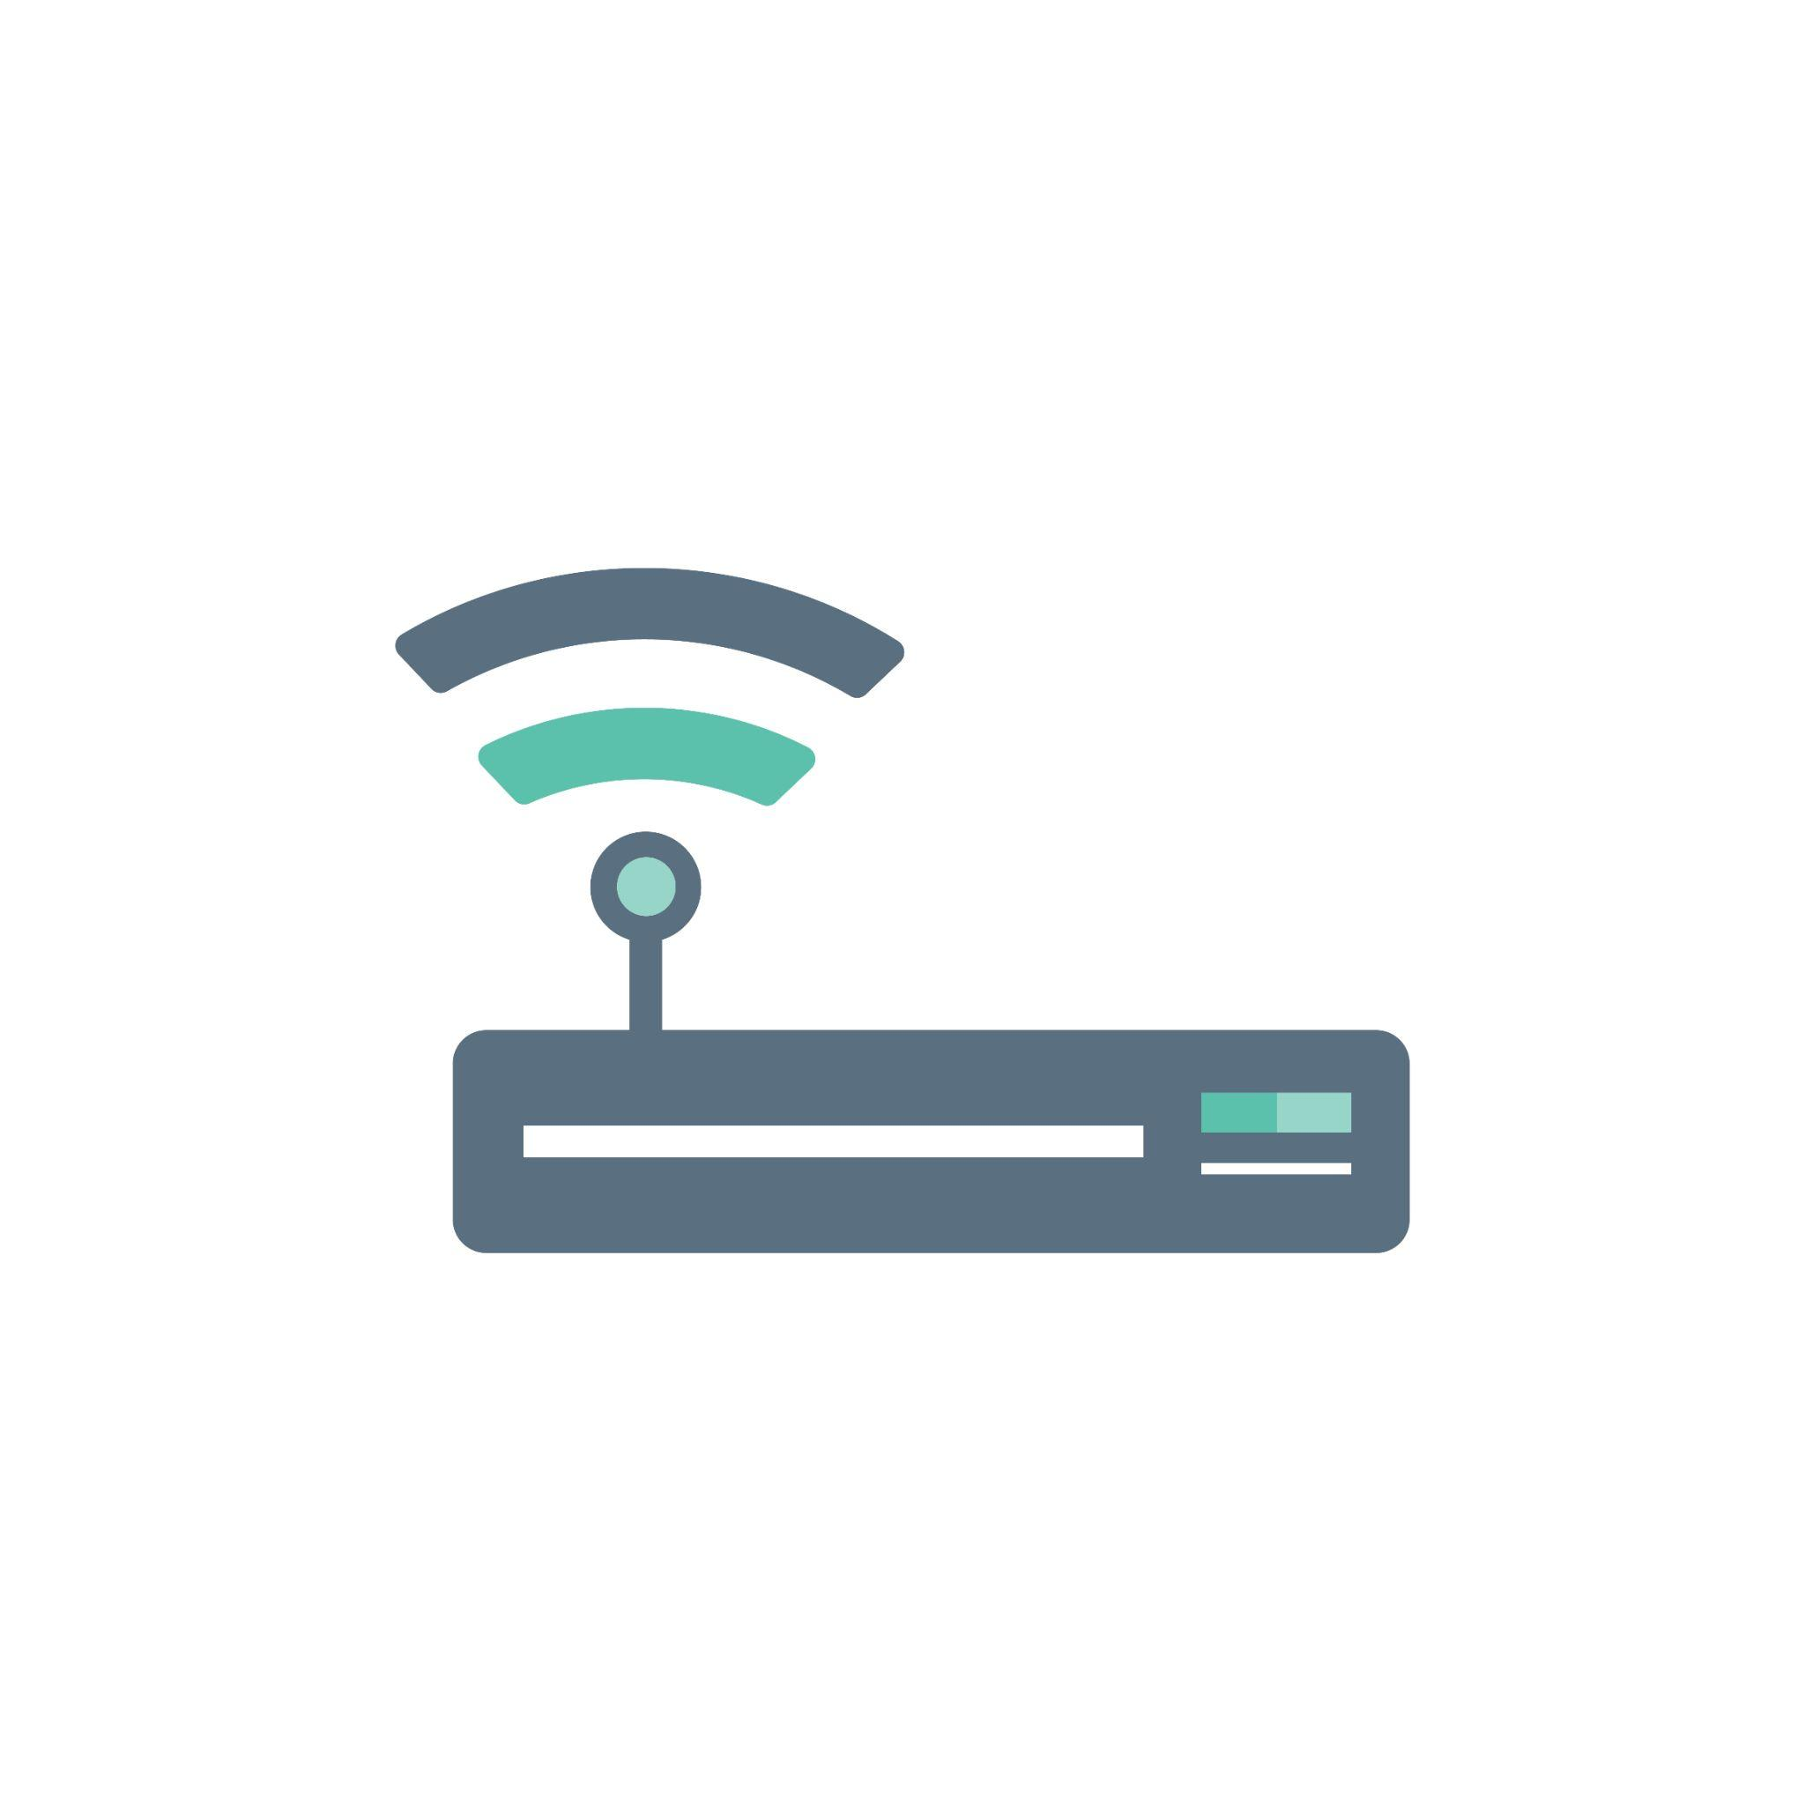



CampusCast Installation

Slide 8
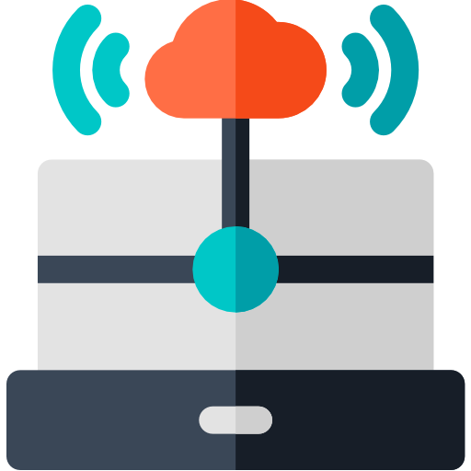
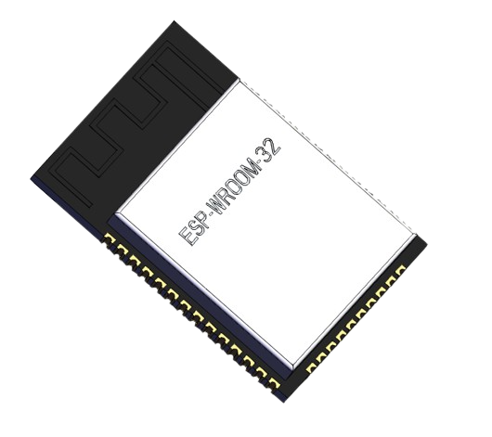
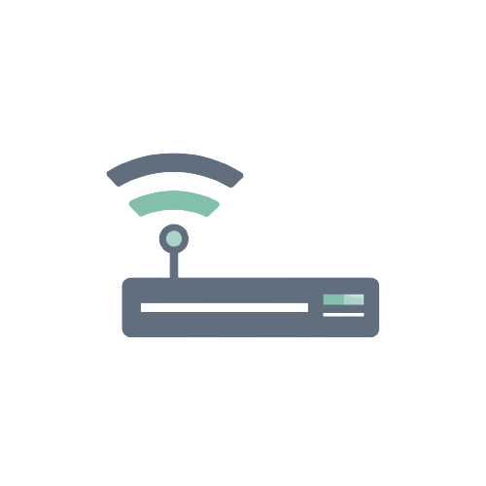
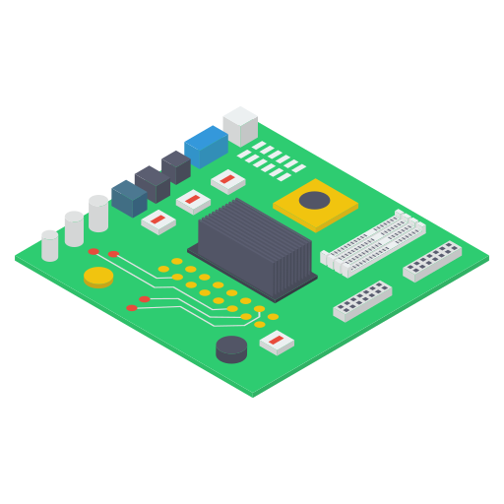
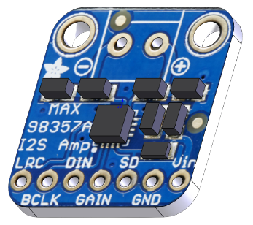

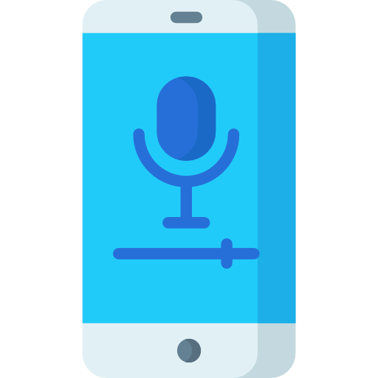
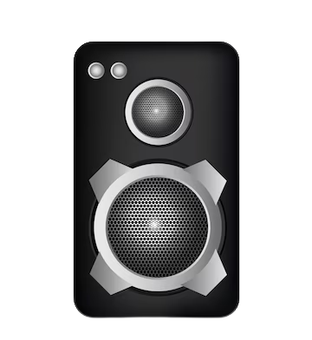
CampusCast System Architecture
Microcontroller
With WiFi & I2S
(ESP32)
CampusCast
IoT Server
WiFi
Network
WiFi Router
Power Amplifier
MAX98357A I2S Amplifier
Acknowledgement Input
CampusCast Mobile App
Traditional Announcement Speakers

Slide 9
Hardware Overview
The hardware that powers CampusCast

Slide 10
Components Used
ESP32: A powerful microcontroller that serves as the brain of the CampusCast system.
MAX98357A I2S Amplifier: A digital-to-analog converter that converts the audio signals from the ESP32 into an analog signal.
Class D Power Amplifier: An amplifier that amplifies the analog signal from the MAX98357A and provides enough power to drive the college wall mount speakers.
Acknowledgement Button: A button that allows the students to acknowledge that they have received a message or announcement. This helps ensure that important information is not missed.

Slide 11
Software Overview
The intelligent software behind CampusCast

Slide 12
Software Overview
Backend IoT server: Planning to use Node-RED or Node.js for the backend IoT server that will handle the communication between the CampusCast devices and the mobile app.
WebSocket: WebSocket technology to establish a real-time connection between the IoT server and the CampusCast devices.
Mobile App: We planning to use React Native to create a mobile app for teachers and authorities to send announcements to the CampusCast devices.

Slide 13
Conclusion
In conclusion, CampusCast is a powerful solution for colleges and universities to improve their communication system with students, faculty, and staff. The system uses IoT technology to deliver announcements, updates, and alerts in a timely and efficient manner. With features such as Exam Time Alerts, CampusCast helps to address common problems faced by college campuses. The combination of hardware and software components provides a user-friendly solution for campuses to modernize their communication system. Overall, CampusCast can enhance the campus experience for everyone involved.

Slide 14




Our Team
Anupam Krishna
Joseph George
Mohammed Ashad MM
Muhammed Ruvais
B20ECA14
B20ECA34
B20ECA42
B20ECA44

Slide 15
Thanks
From

